Slide 1
VERILOG HDL FPGA USING ZYBO
ARJIT AVADHANAM – S20210020257
Projects Implemented:
1.Full Adder Circuit
2.4:2 Encoder Circuit
3.Pulse Width Modulation using LEDs
4.Simple Pong game
5.Super Mario Run game

Slide 2
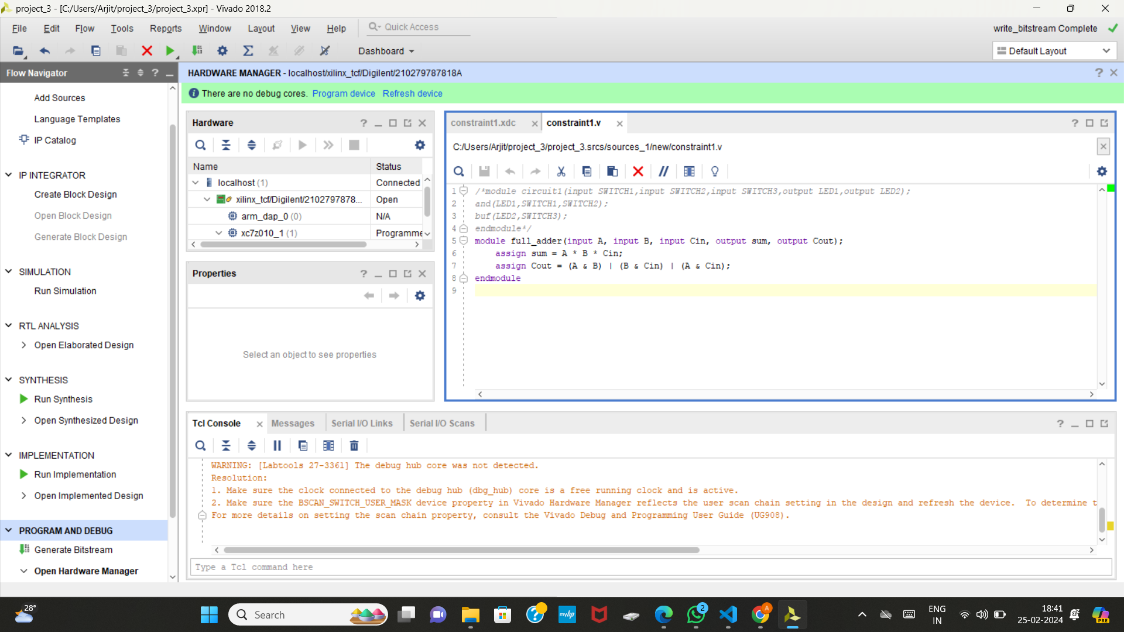
Full Adder:

Slide 3
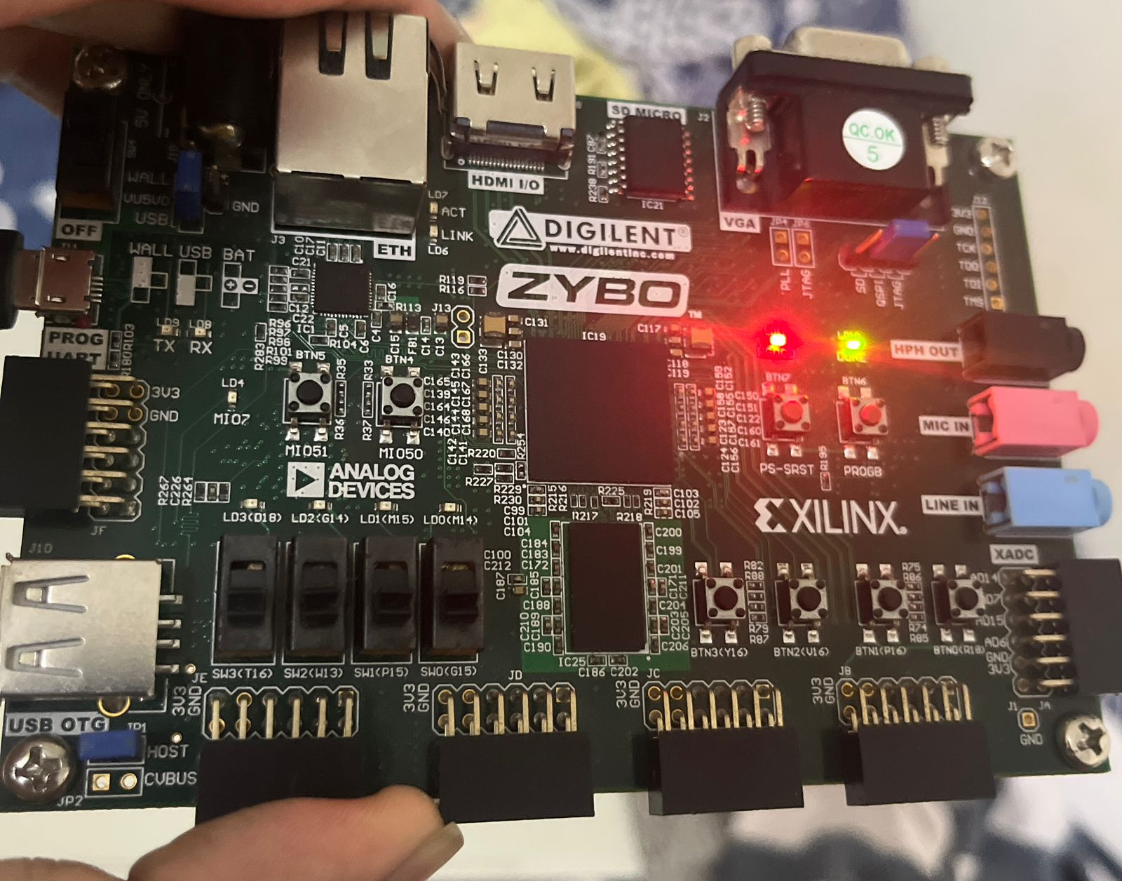
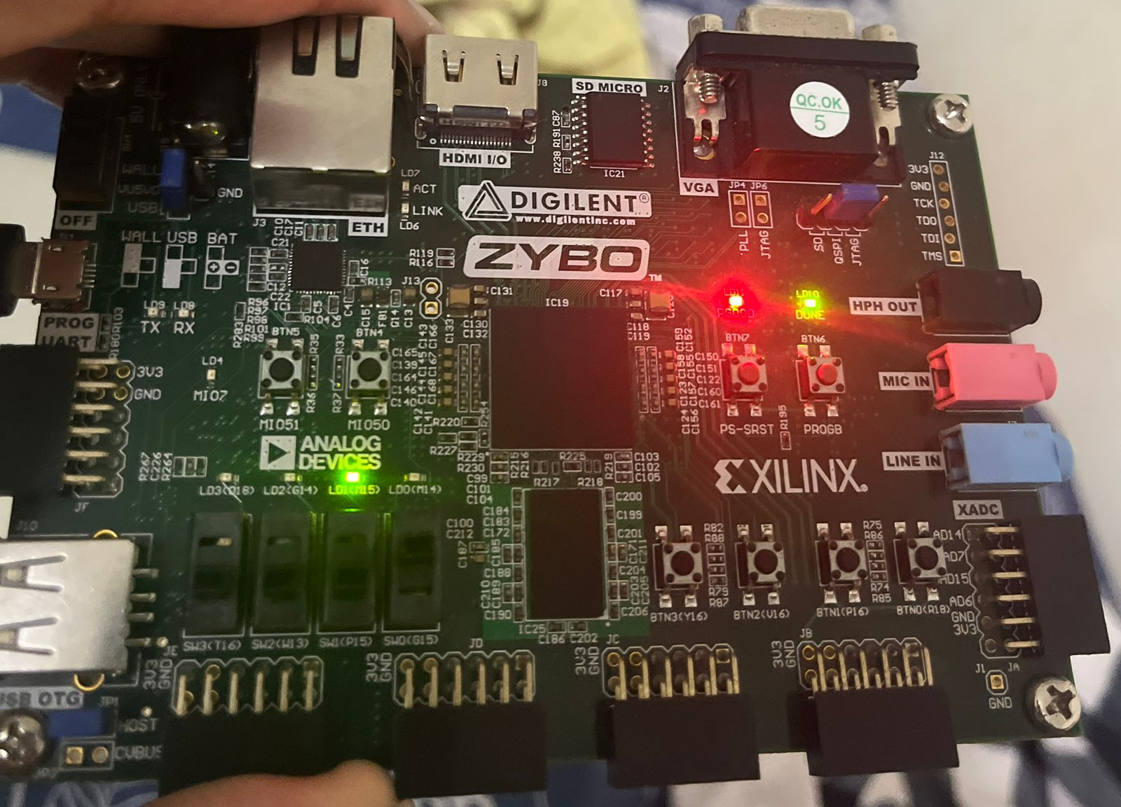
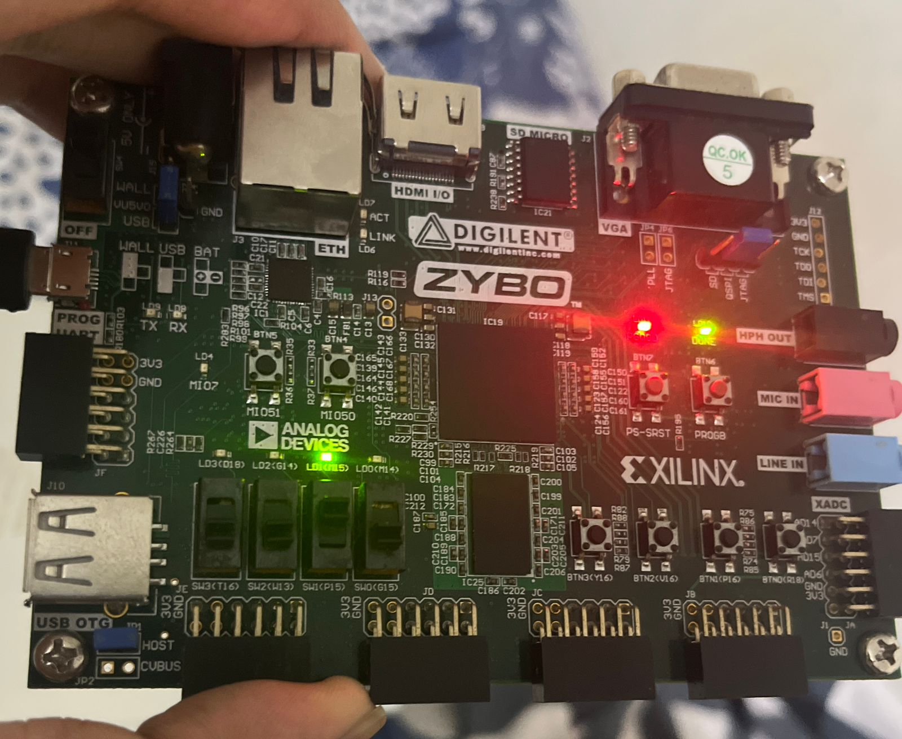
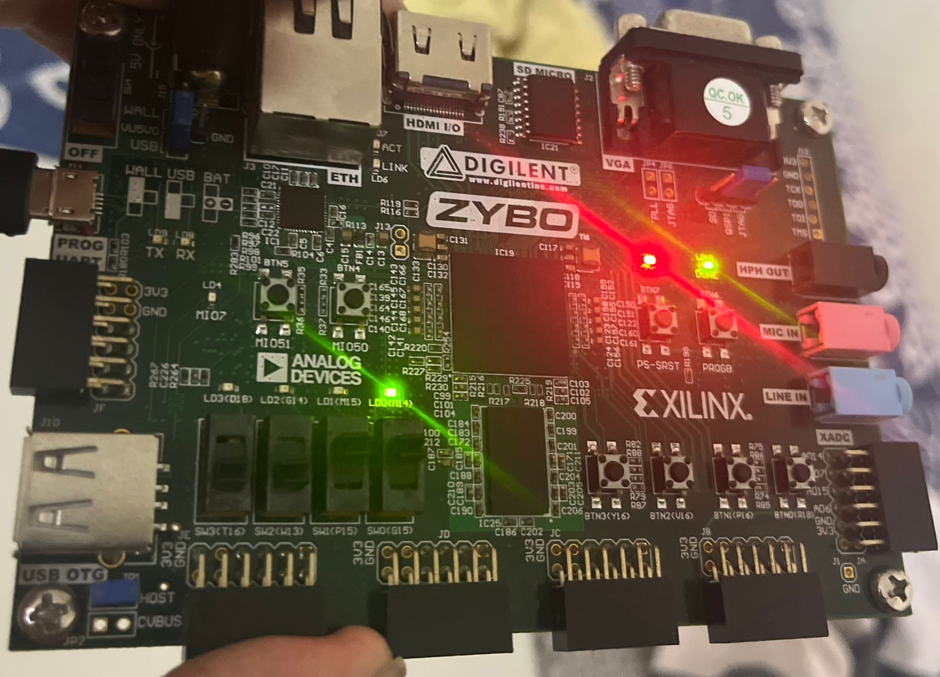
0 0 0
0 0 1
0 1 0
0 1 1

Slide 4
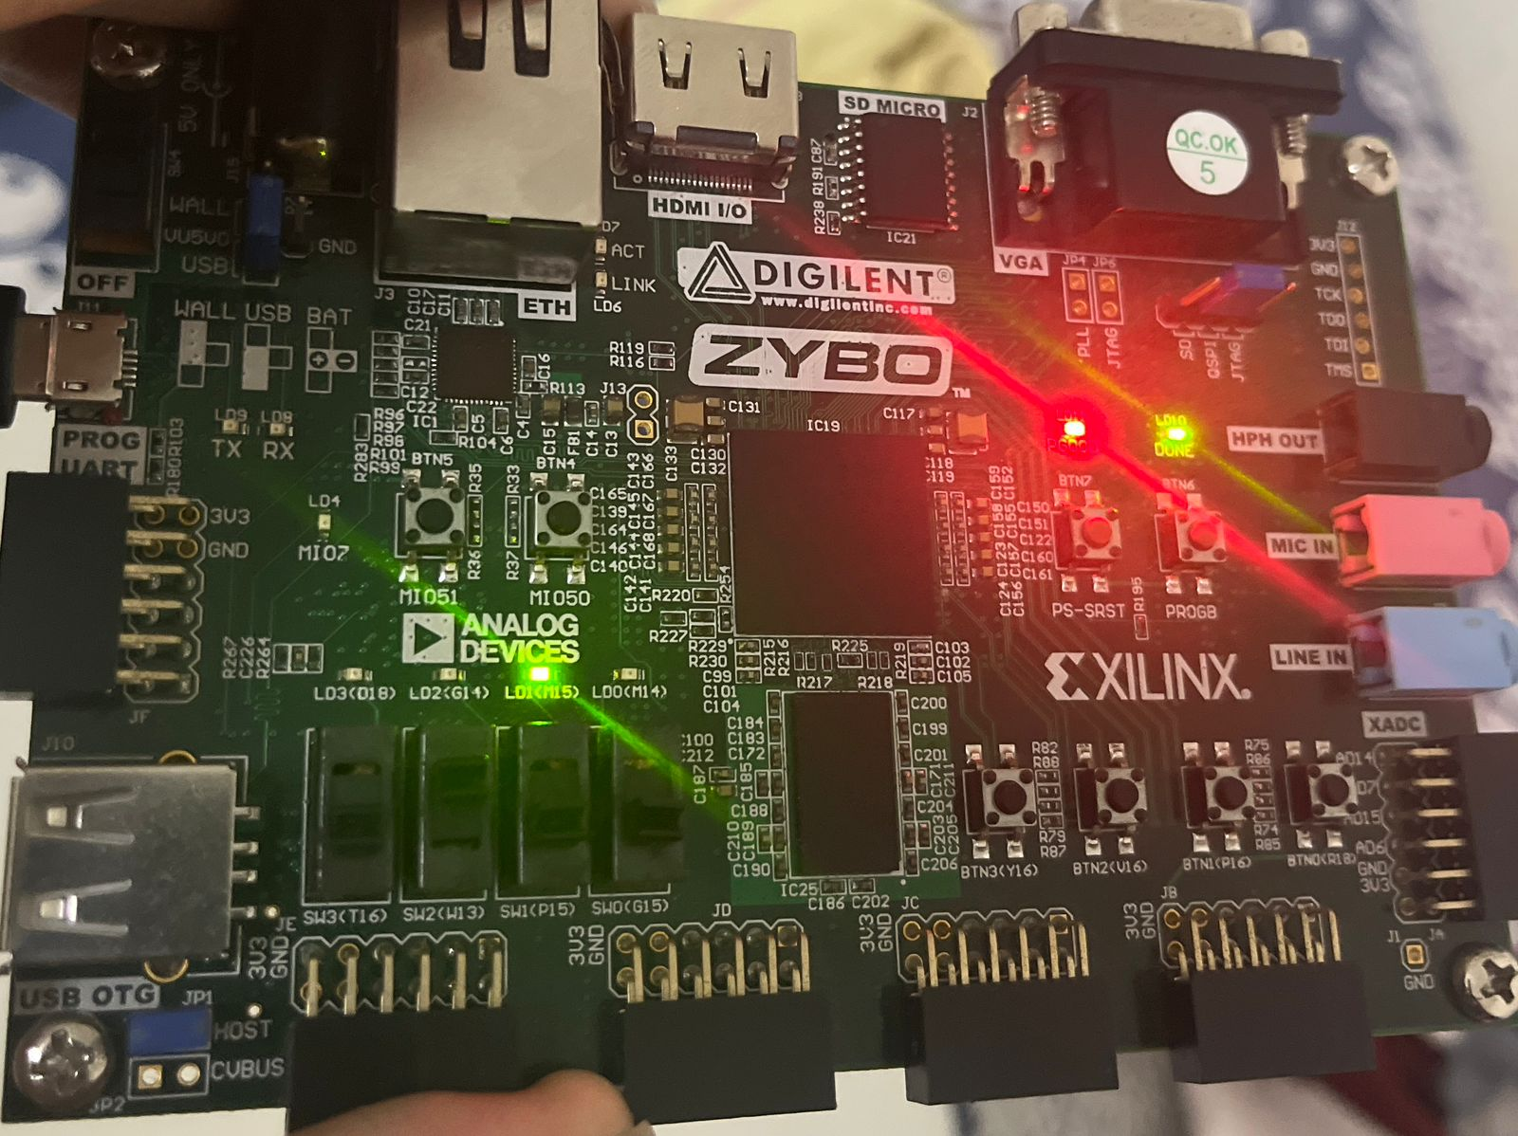
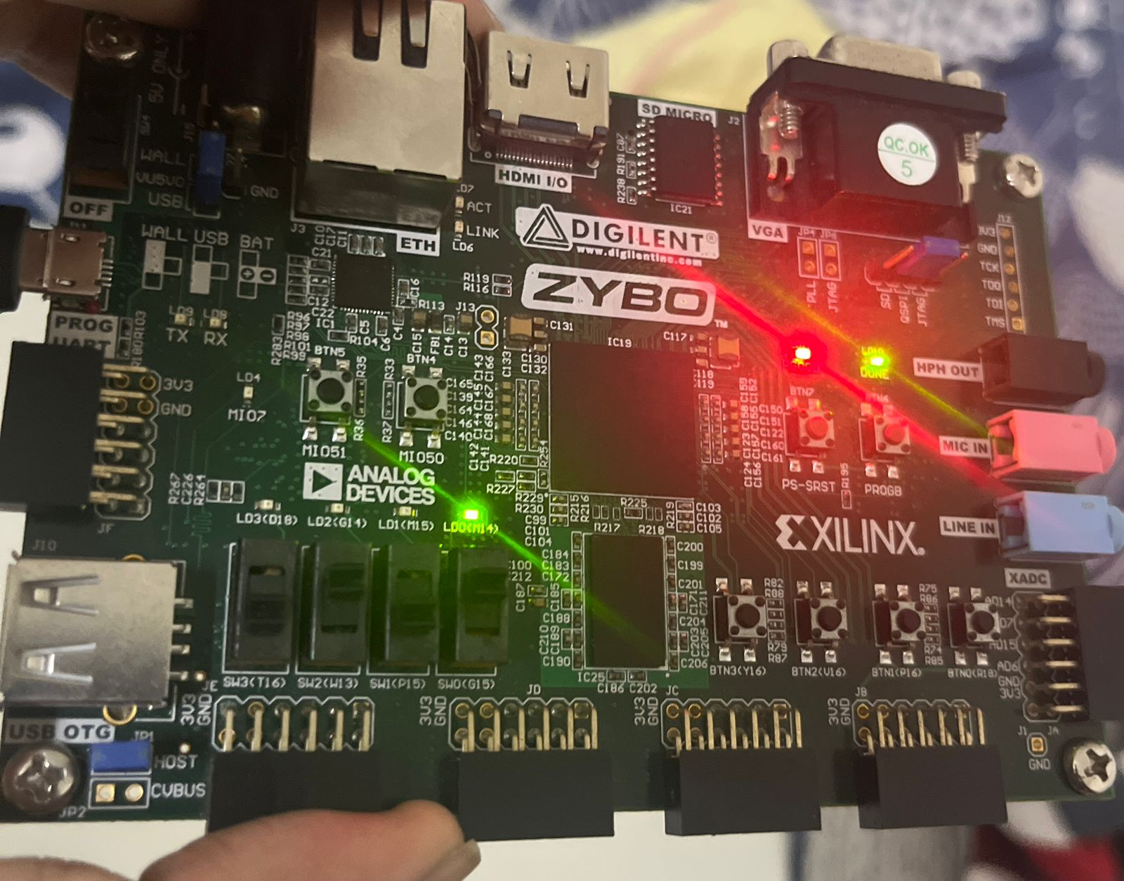
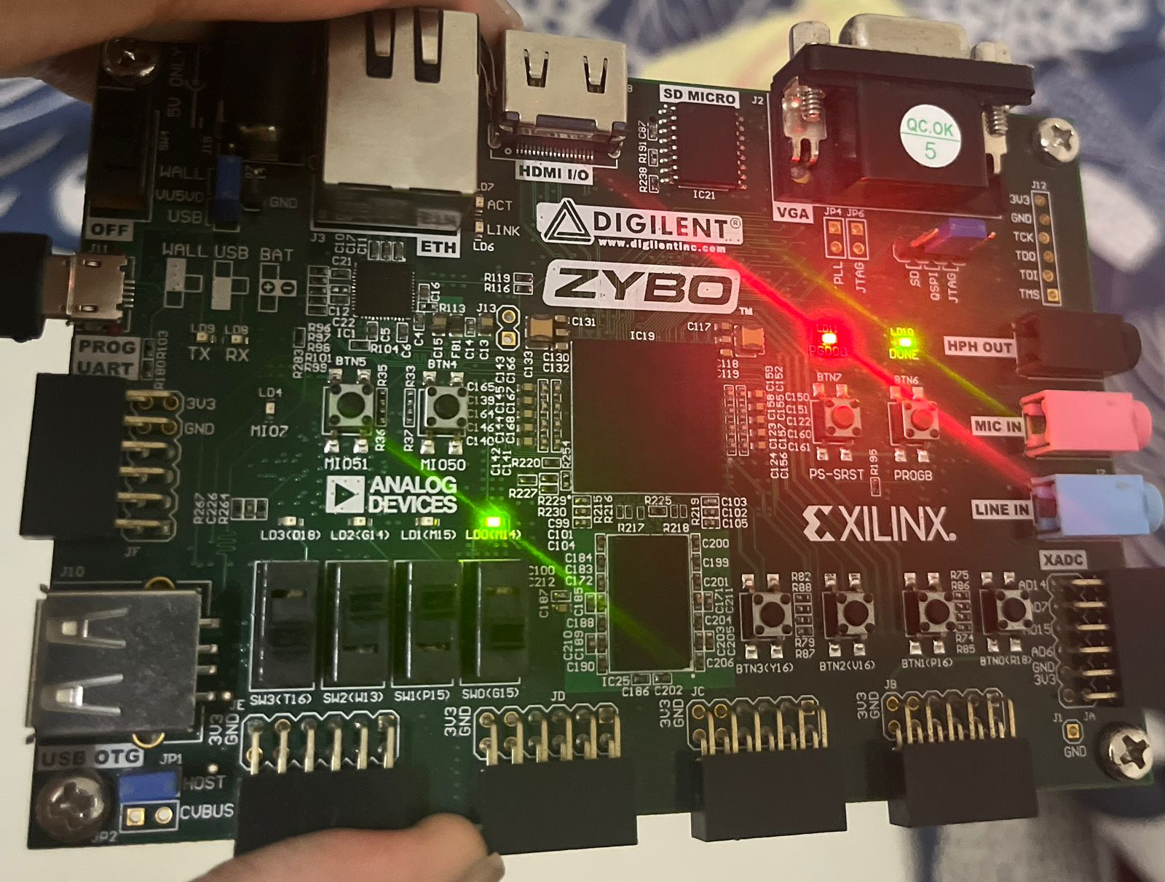
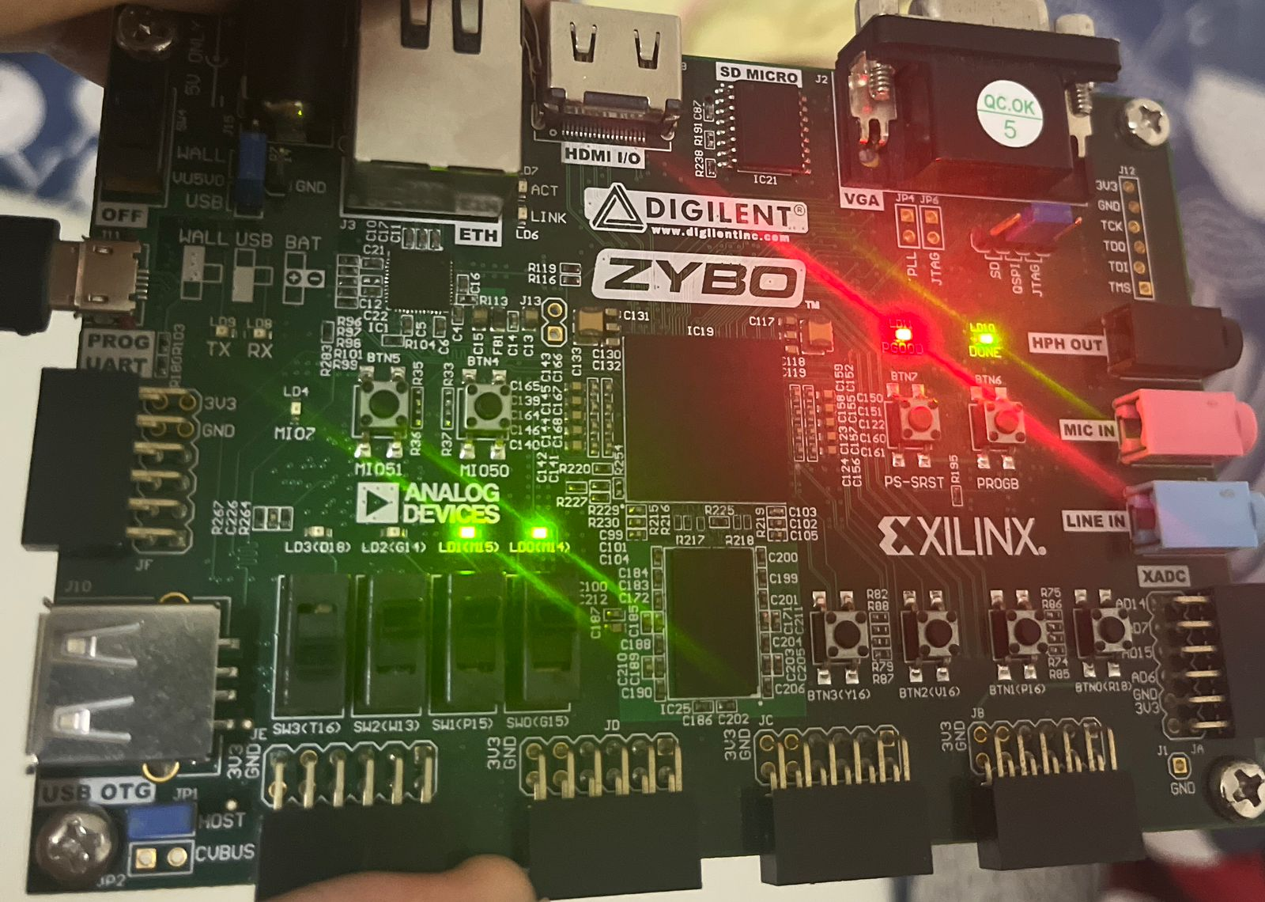
1 0 0
1 0 1
1 1 0
1 1 1

Slide 5
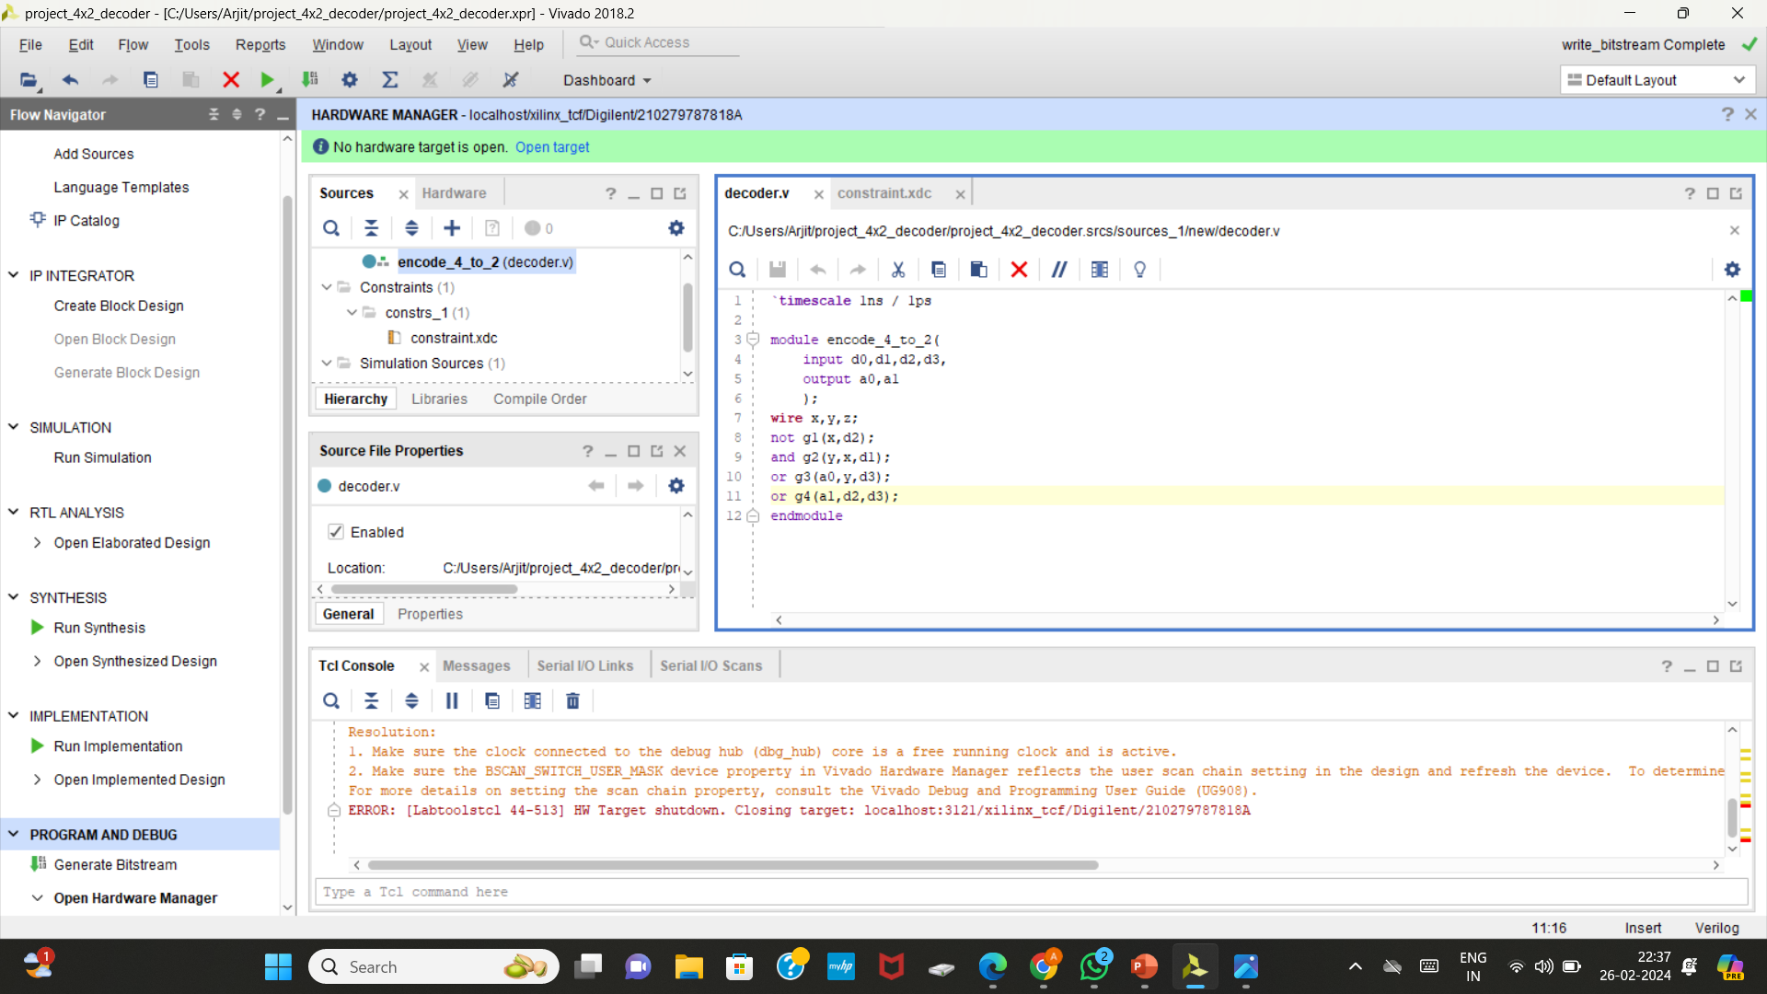
4:2 Encoder:

Slide 6
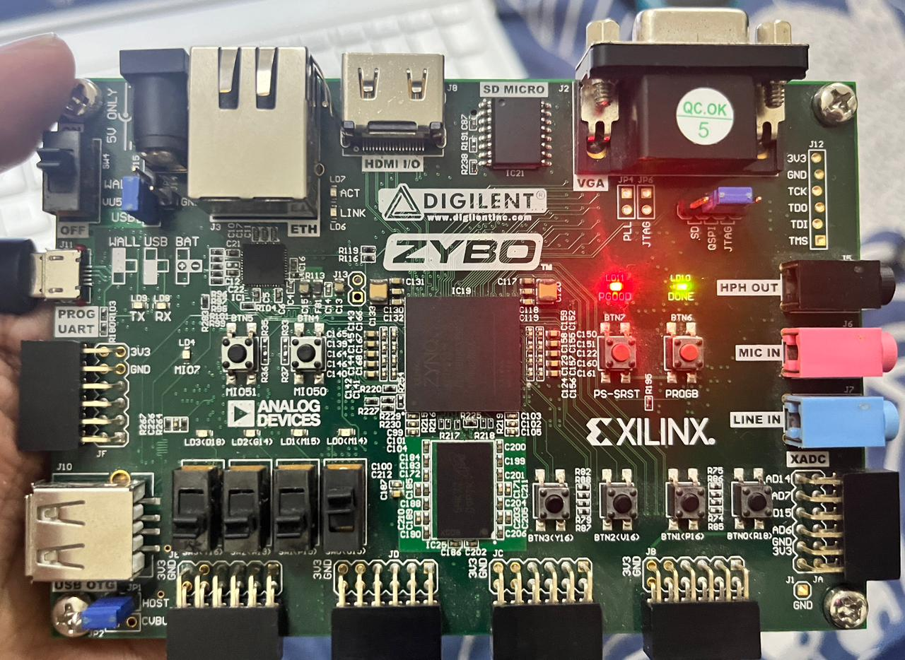
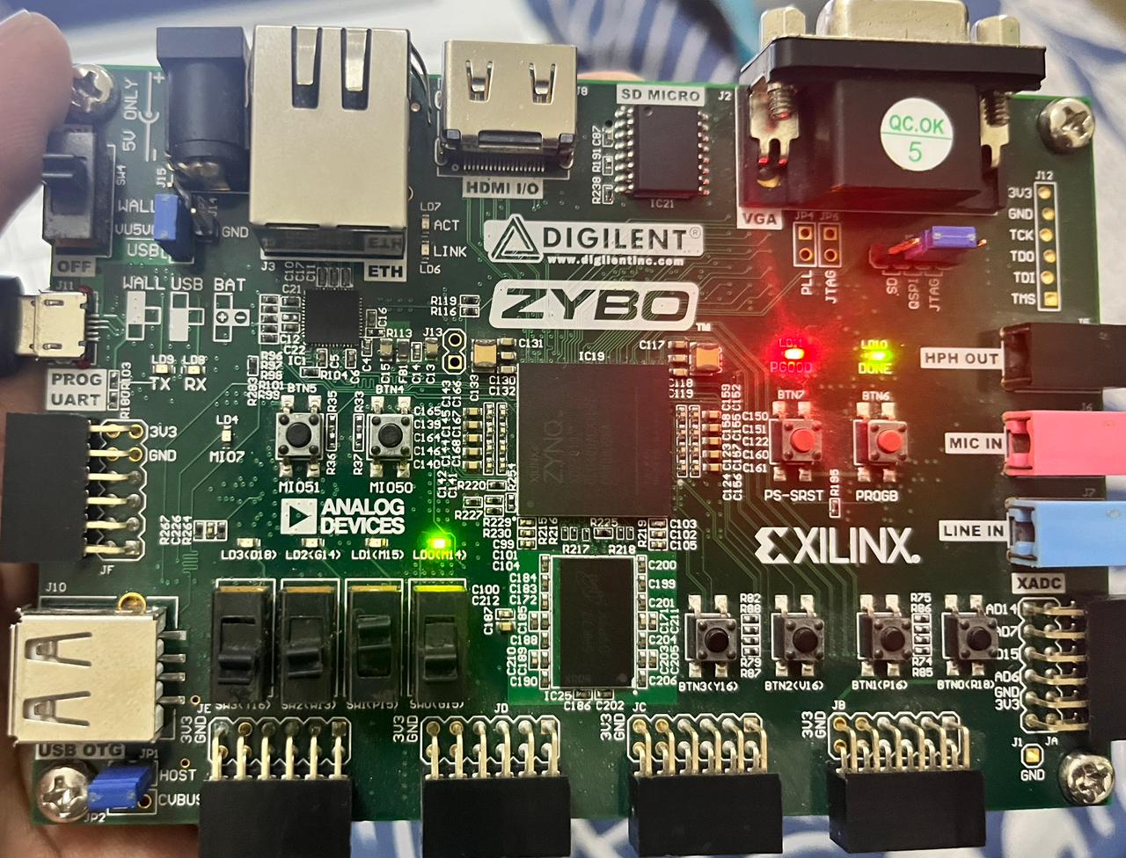
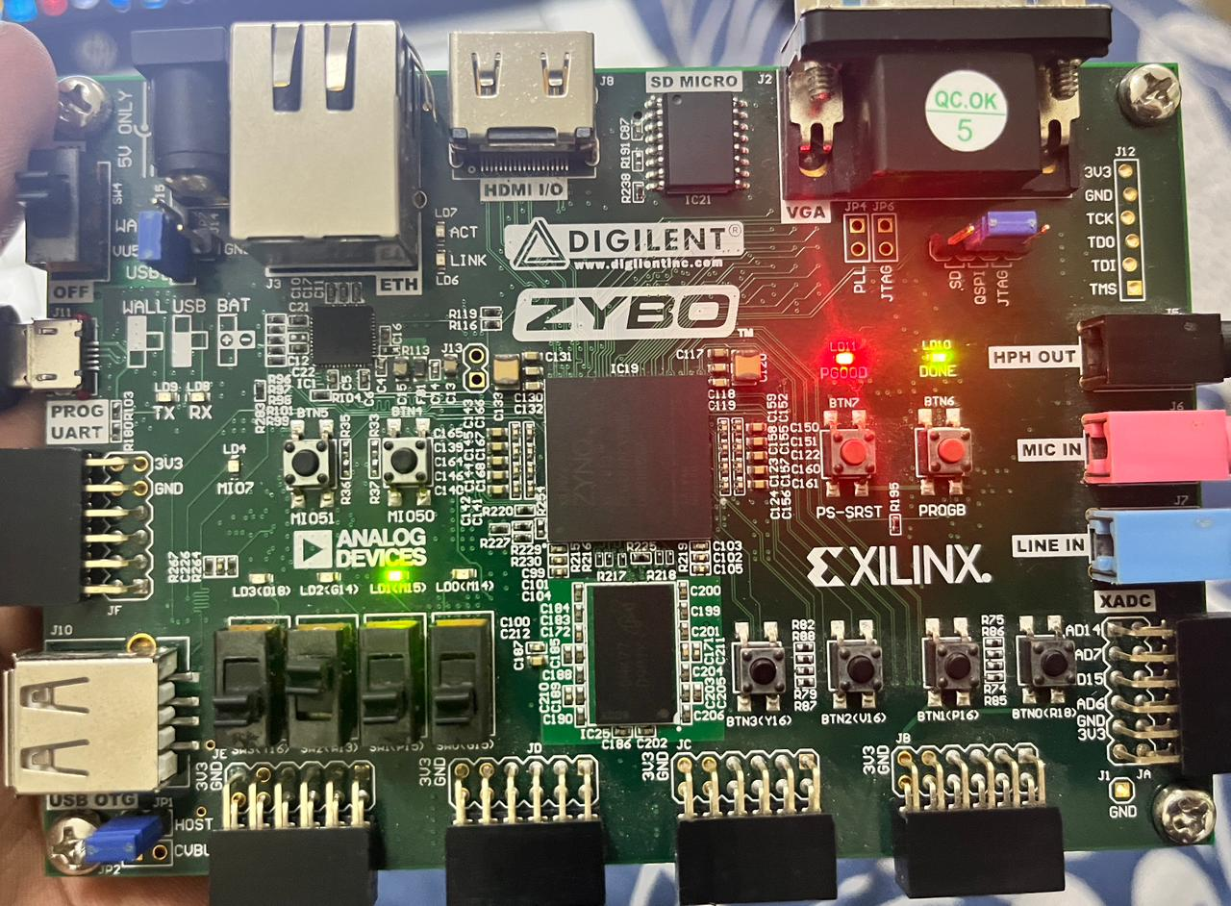
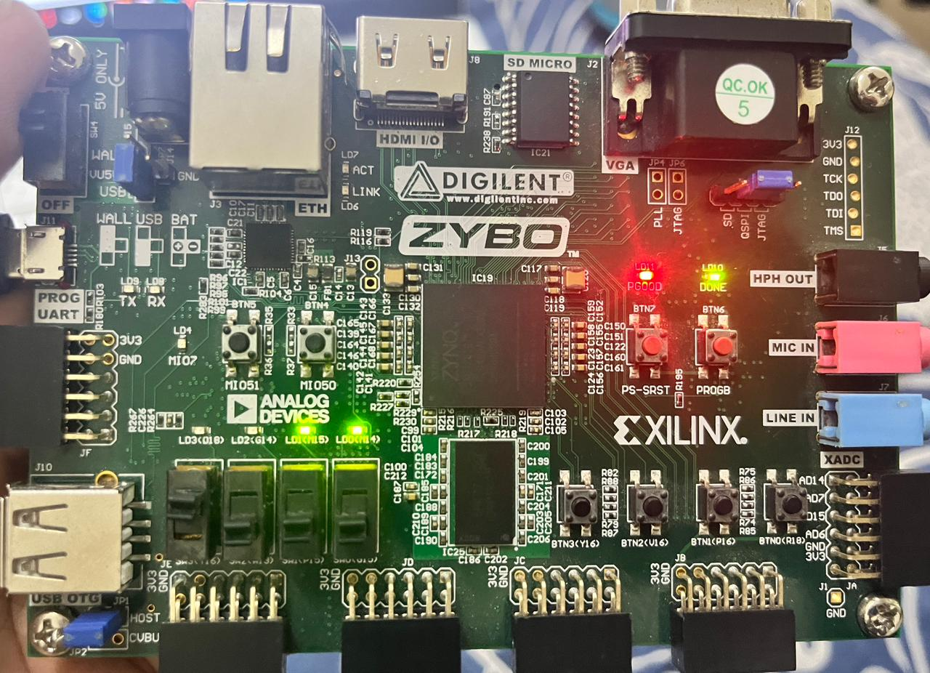
0 0 0 1
0 0 1 0
0 1 0 0
1 0 0 0

Slide 7
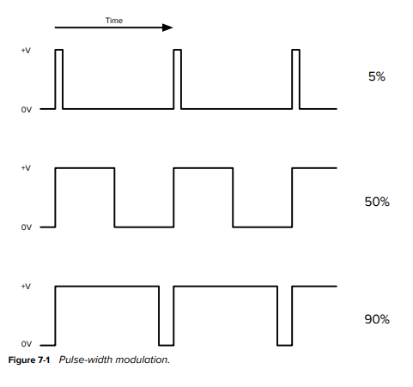
Pulse Width Modulation:
Figure shows how PWM works. If the pulses are short (say, high for just 5 percent of the time), then only a small amount of energy is delivered with each pulse. The longer the pulse, the more energy is supplied to the load. When powering a motor, this will control the speed at which the motor rotates. When driving a LED using PWM, the brightness appears to change. In fact, a LED can turn on and off millions of times per second, so the PWM pulses will become pulses of light. The human eye and brain do the averaging trick for us, making the apparent brightness of the LED vary with the pulse length.

Slide 8
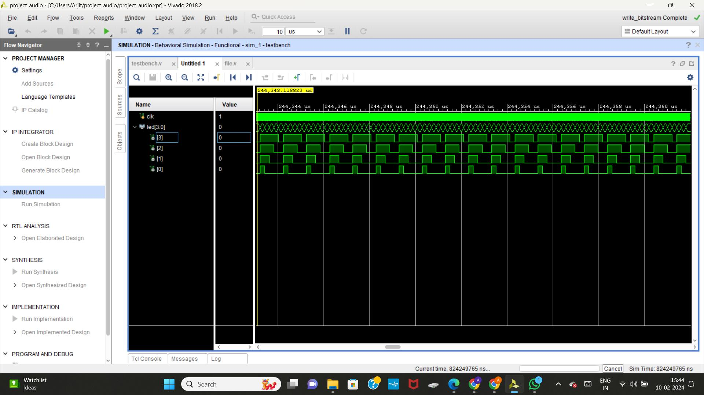

Slide 9
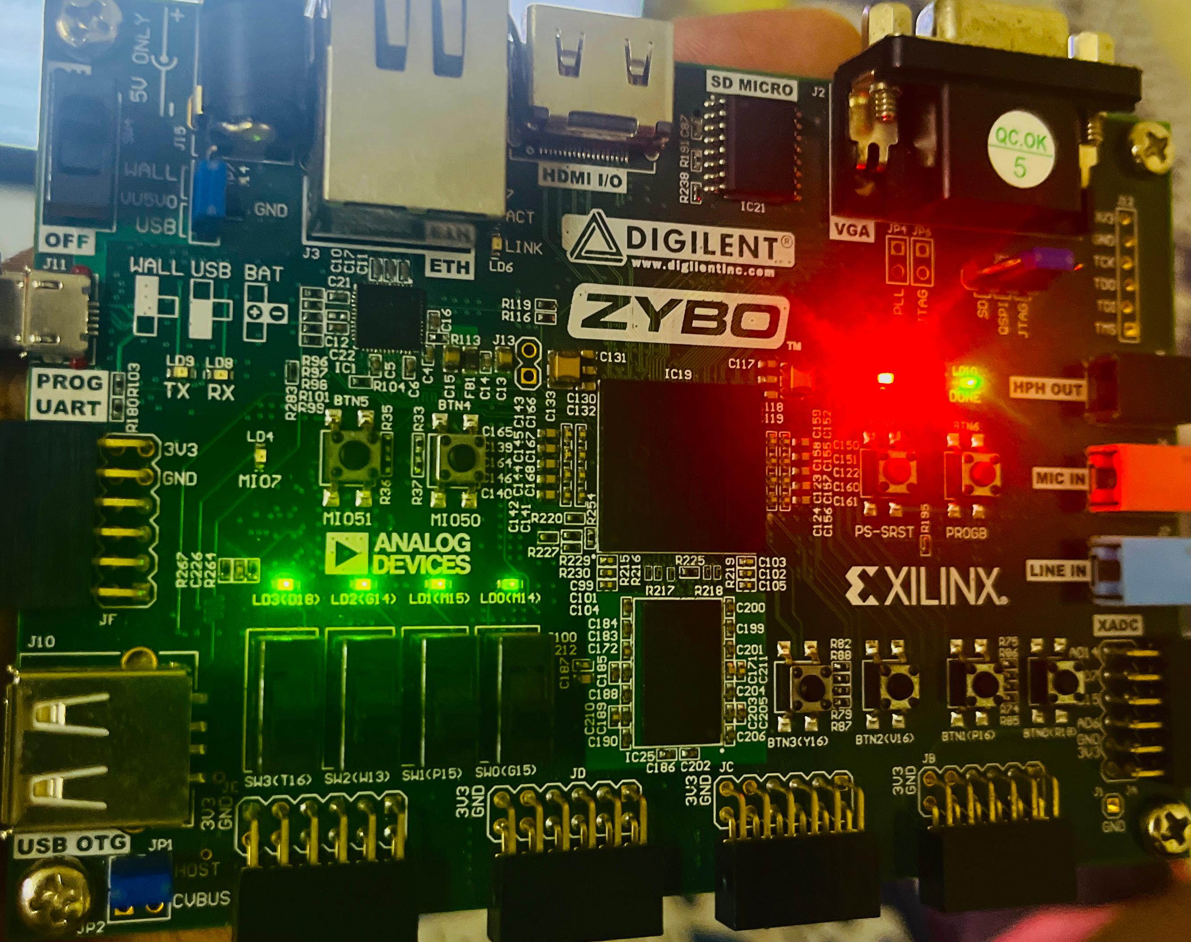

Slide 10
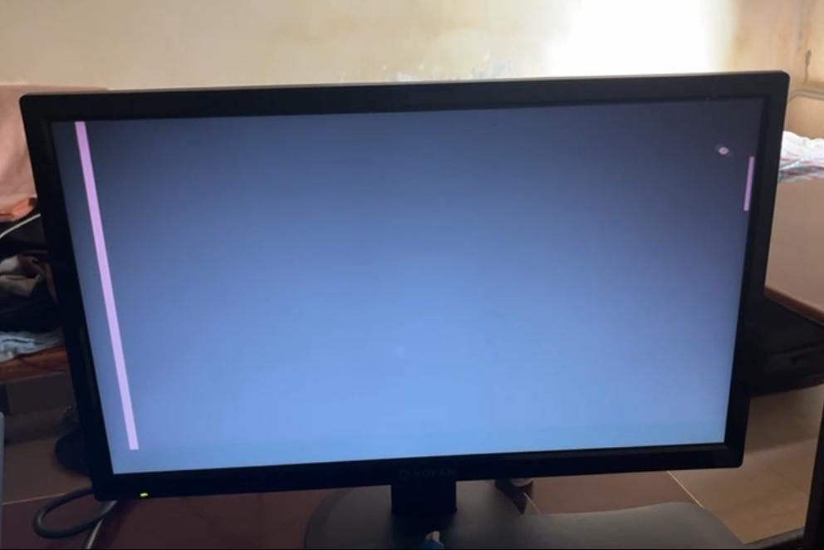
Pong Game:

Slide 11
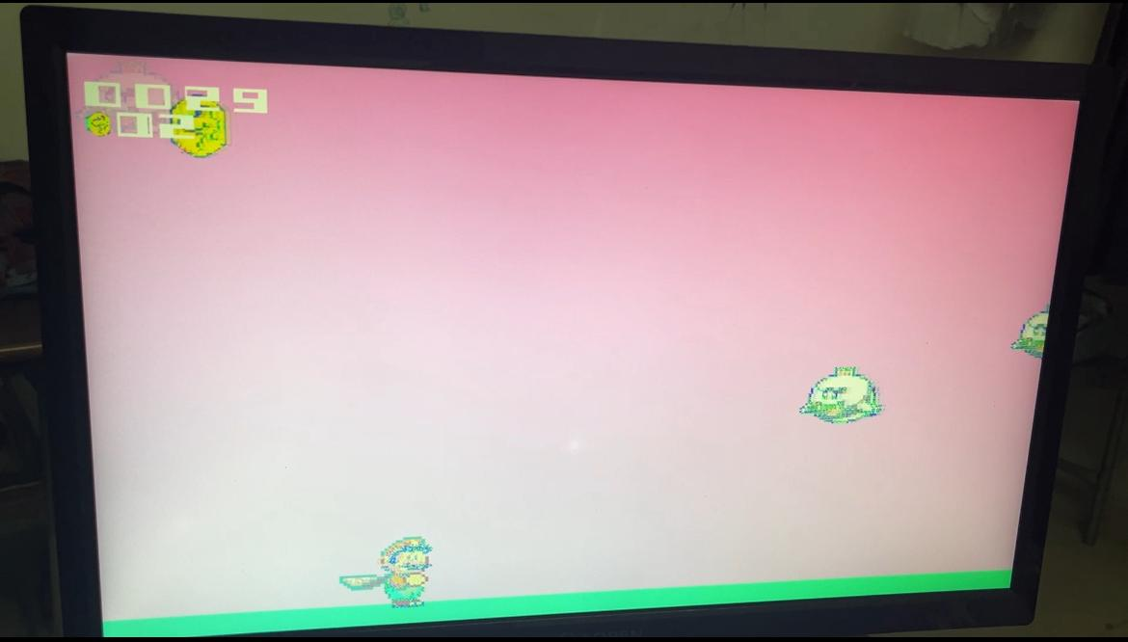
Super Mario Game:

Slide 12
THANK YOU

